Slide 1

Charlie Group
Robert Stewart
Juan Partida-Jacinto
Sean Dudley

Slide 2
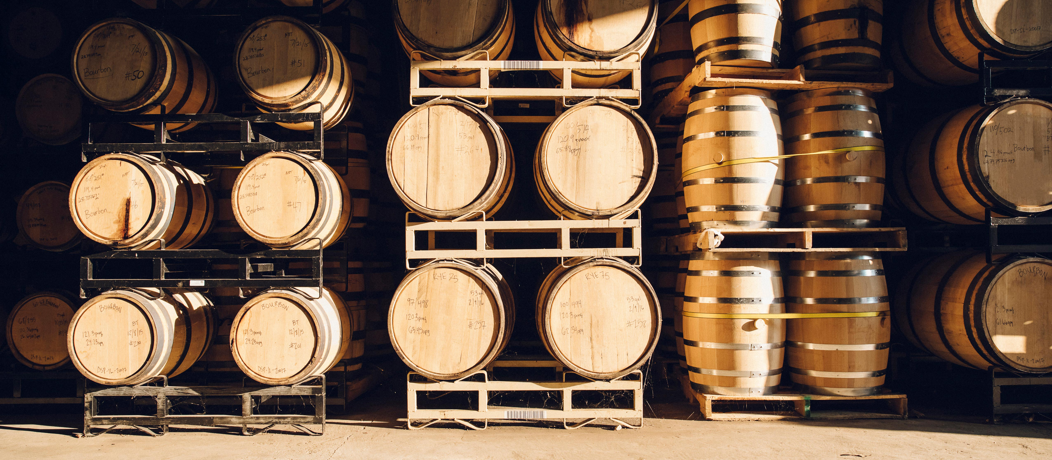
Bacchus Winery Case Study

Slide 3
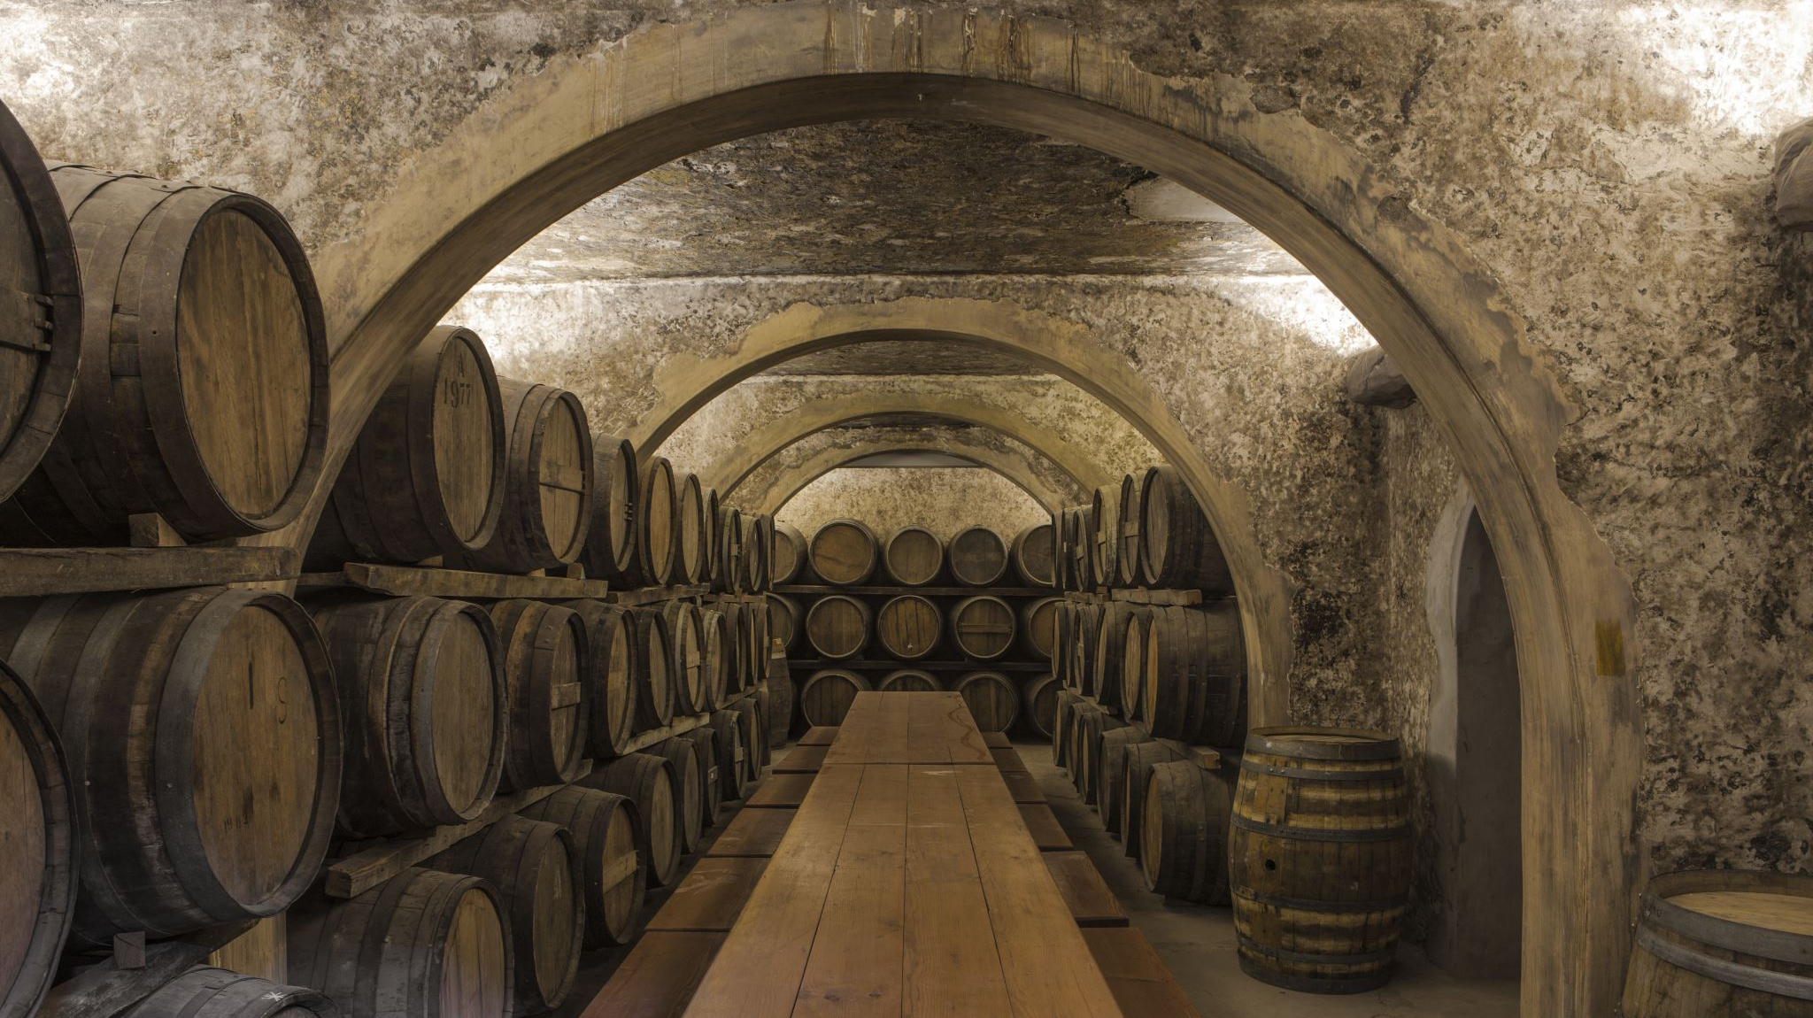
History and Background of Bacchus Winery

Slide 4
Background
Stan and Davis Bacchus inherited the winery from their father, George, and are eager to modernize business practices.
Existing personnel include Janet Collins (finance and payroll), Roz Murphy (marketing), Bob Ulrich (assistant to Roz), Henry Doyle (production manager), and Maria Costanza (distribution).

Slide 5
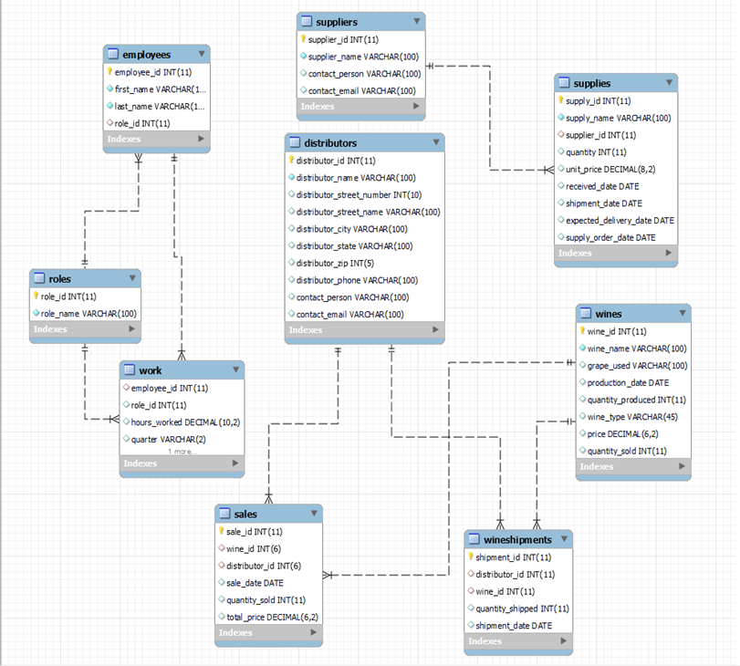
Finalized ERD Diagram

Slide 6

Assumptions
Assumptions:
The winery's existing data management methods need upgrading to support modern business operations.
Online platforms will enhance supply chain and distribution processes.
Detailed reports will provide actionable insights for business decisions.

Slide 7
Key Objectives for Bacchus Winery
Supply Management
Distribution Optimization
Employee Time Tracking
Sales Analysis

Slide 8
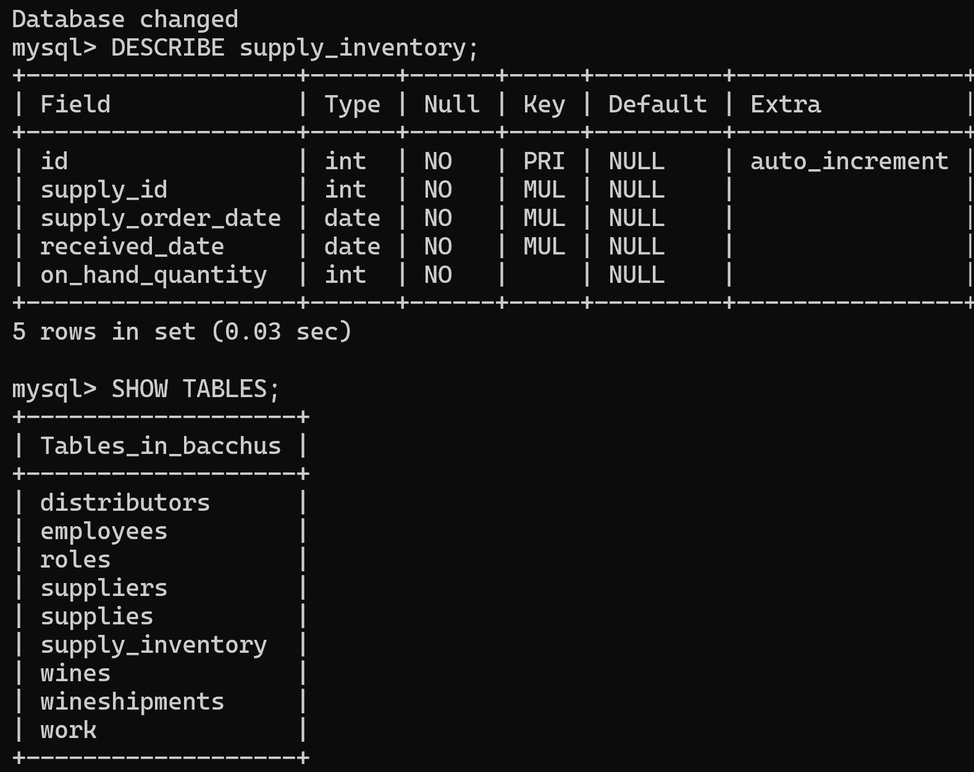
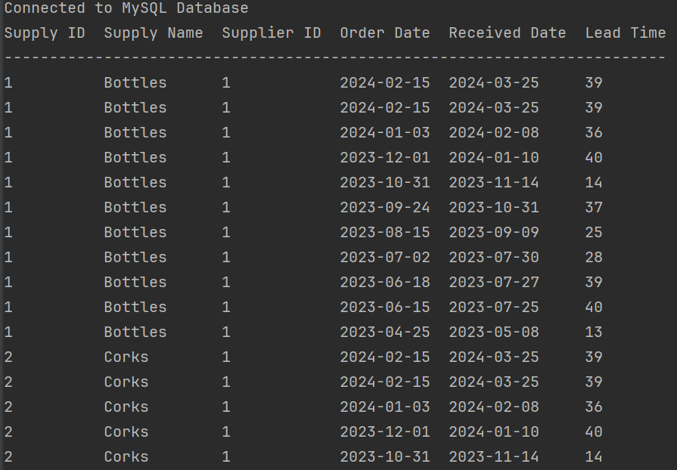
The picture above is showing all tables in our database. I have shown the latest one for supplies, which will be shown on a later slide query_1 produces a list of each supply that is being purchased. The report shown is a master list of all supply orders. query = "SELECT supply_id, supply_name, supplier_id, supply_order_date, received_date, lead_time FROM supplies" cursor.execute(query) rows = cursor.fetchall()
query_1 Report – Main Supply List

Slide 9
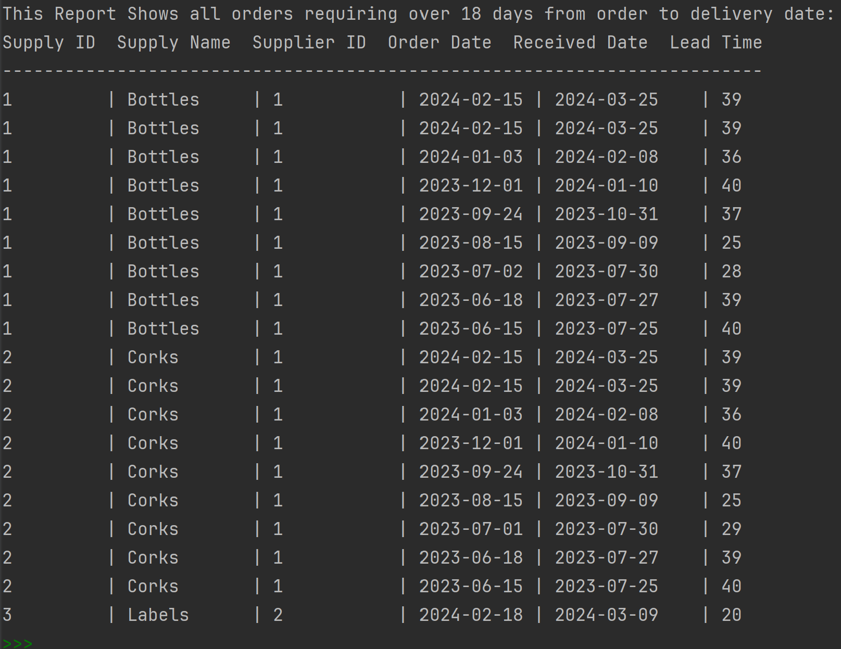
query_2 has been built to show each supply that has taken 18 or more days from the time of ordering until they were delivered. The Winery is looking at increasing sales, so we much be able to receive our supplies in a timely manner. query_2 = "SELECT supply_id, supply_name, supplier_id, supply_order_date, received_date, lead_time FROM supplies WHERE lead_time >= '18'" cursor.execute(query_2) rows_2 = cursor.fetchall()
query_2 Report – List of supply shipments over 18 days from order to delivery

Slide 10
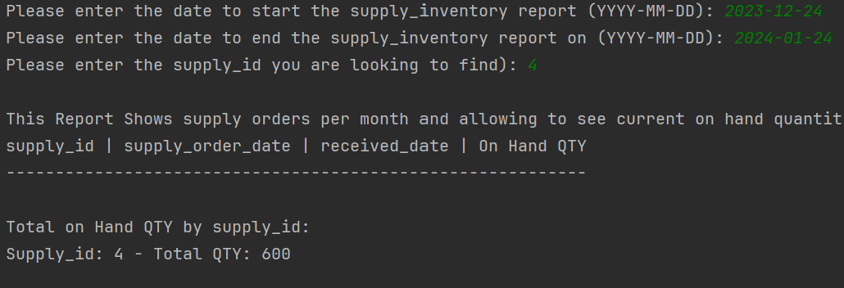
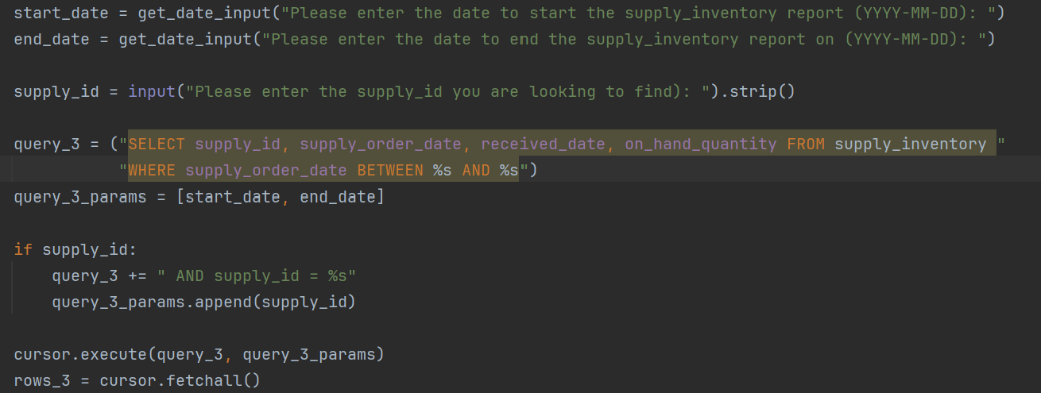
This report has been created for the user to enter in two date, which coincide with the order_date and the received_date. The user would also enter in which supply they were looking for, to see the current number of on-hand supplies.
query_3 Report – Monthly report for on hand supplies

Slide 11
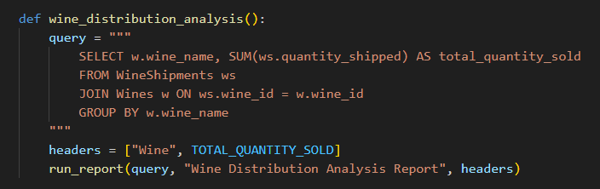
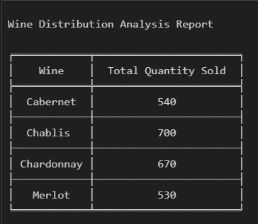
Report 2
Query # 1 - Wine Distribution Analysis Report
This report summarizes the total quantity sold for each wine

Slide 12
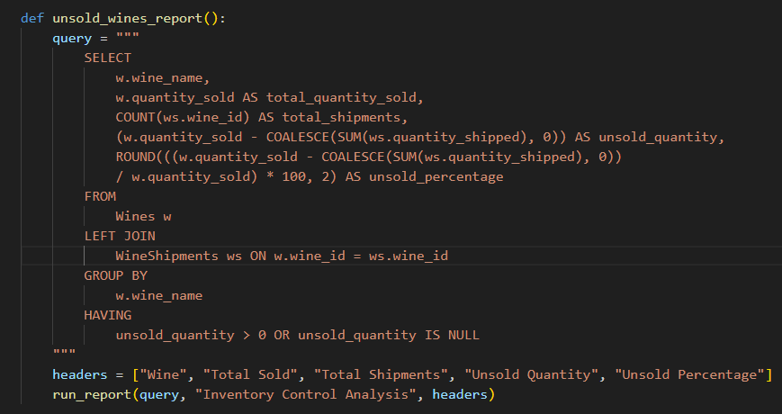
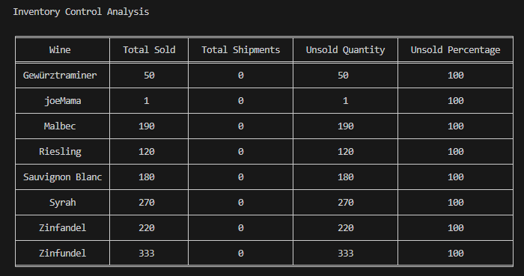
Report 2 cont.
Query #2 – Inventory Control Analysis
This report identifies which wines have not been sold and calculates the percentage of unsold wines.

Slide 13
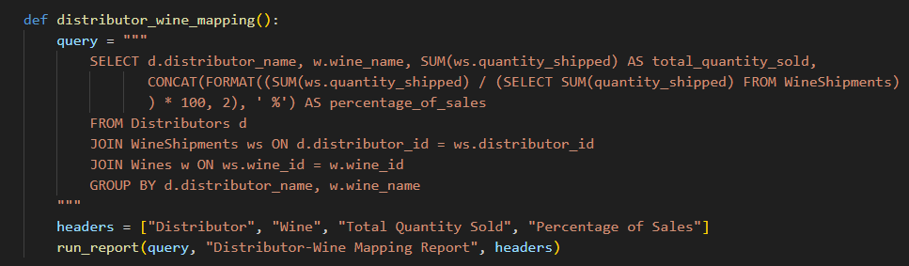
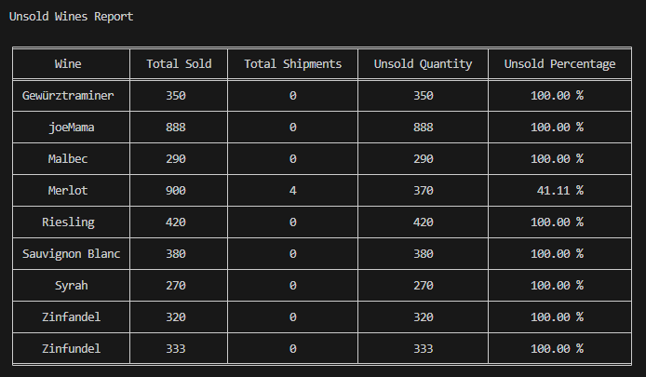
Report 2 cont.
Query # 3 - Wine Distribution Mapping
Maps distributors to the wines they distribute and shows the quantity sold and the percentage of total sales.

Slide 14
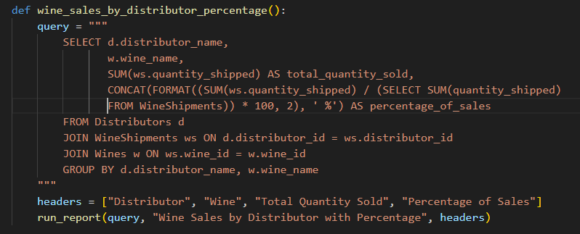
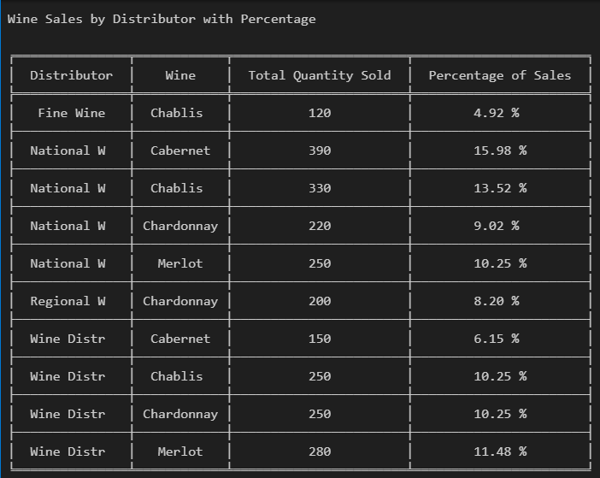
Report 2 cont.
Query # 4 – Individual Distributor Sales Report
Identifies wines , distributors, quantities , and shows unsold wine percentage.

Slide 15
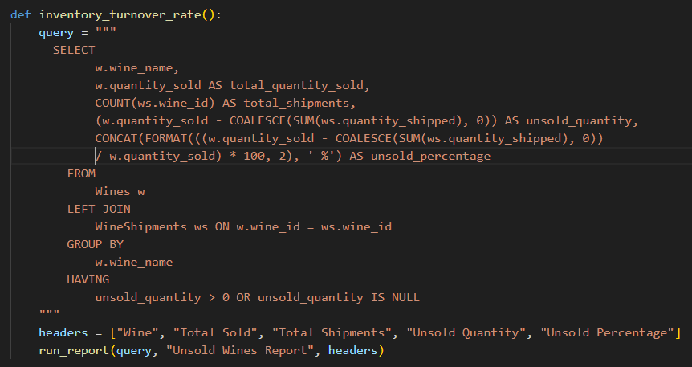
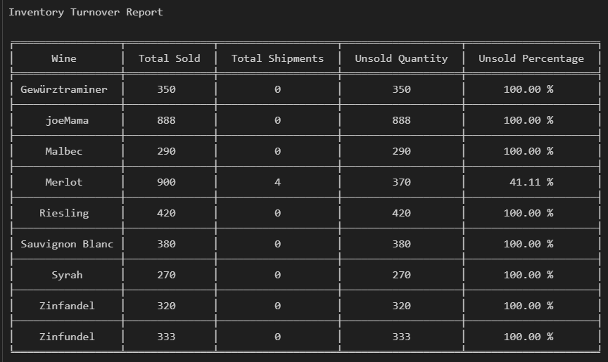
Report 2 cont.
Query # 5 – Inventory Turnover Rate
Analyzes the inventory turnover rate for each wine.

Slide 16
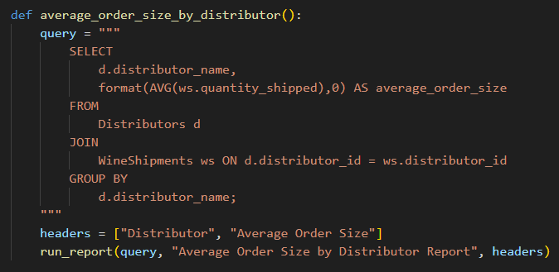
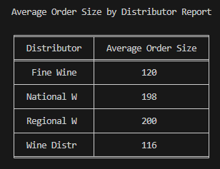
Report 2 cont.
Query # 6 – Average Distributor Order Size
Calculates the average order size for each distributor.

Slide 17
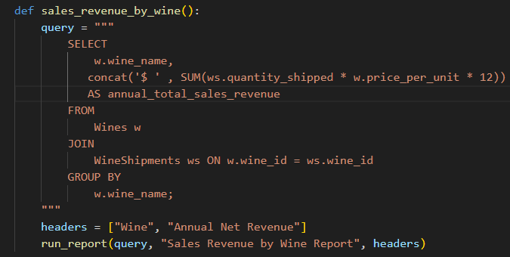
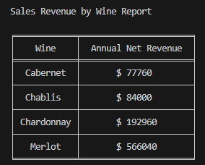
Report 2 cont.
Query # 7 – Sales Revenue by Wine
Analyzes total sales revenue generated by each wine.

Slide 18
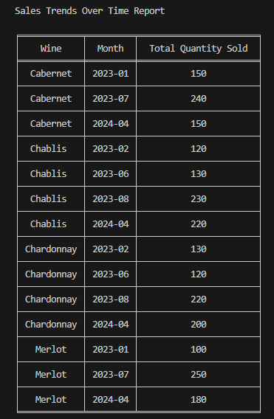
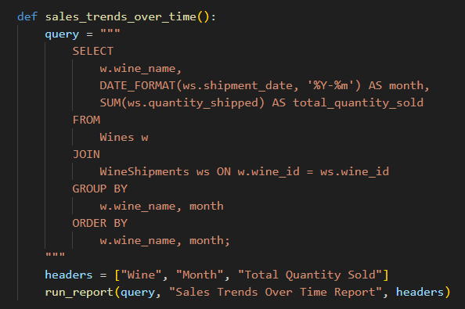
Report 2 cont.
Query # 8 – Annual Sales Trends
Analyzes sales trends over time for each wine.

Slide 19
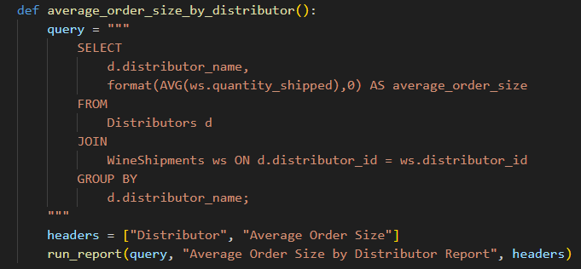
Report 2 cont.
Query # 9 – Average Order Size by Distributor
Calculates the average order size for each distributor.

Slide 20
Report 2 cont.
Query # 10 – Sales Revenue by Wine
Analyzes total net sales revenue generated by each wine.

Slide 21
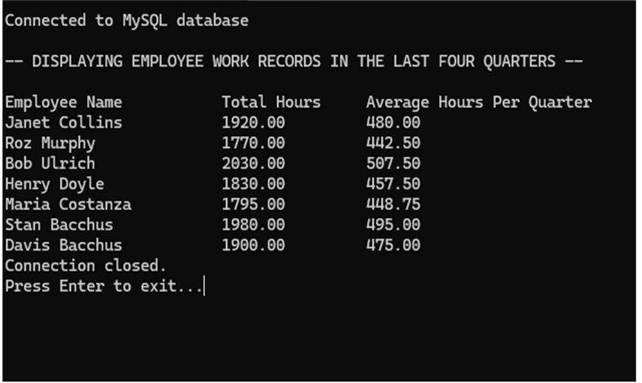
Report 3
Hours Worked Report
Description: This query is useful for getting a clear overview of employee work hours, both total and average per quarter, which can help in assessing planning.
Query: SELECT CONCAT(employees.first_name, ' ', employees.last_name) AS employee_name,
ROUND(SUM(Work.hours_worked), 2) AS total_hours,
ROUND(SUM(Work.hours_worked) / COUNT(DISTINCT Work.quarter), 2) AS average_hours_per_quarter
FROM Work
JOIN employees ON Work.employee_id = employees.employee_id
JOIN (SELECT DISTINCT quarter FROM Work ORDER BY quarter DESC LIMIT 4) AS recent_quarters ON Work.quarter = recent_quarters.quarter
GROUP BY employees.employee_id
LIMIT 0, 400;

